Slide 1


A Career In Optometry

Slide 2


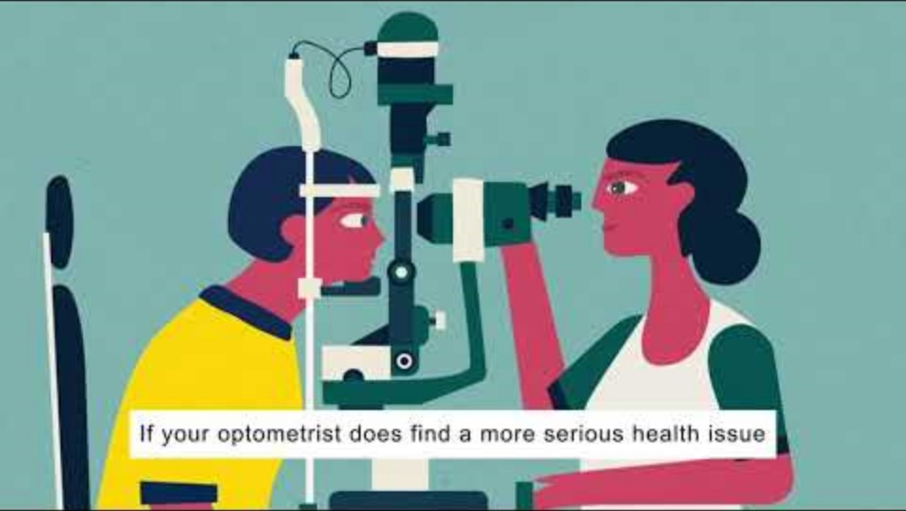
What is an Optometrist?
https://youtu.be/UAm8HDMK_es?si=tUnxLKoOIrfa-1Fr

Slide 3
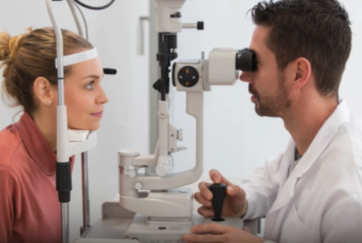

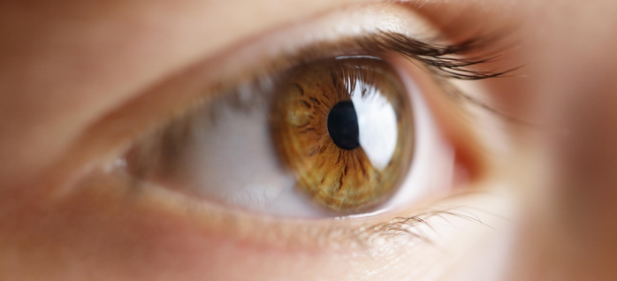
‘Doctor of the eyes’ on the high street
Detecting eye disease
Treating eye disease
Monitoring eye disease
Correcting vision

Slide 4
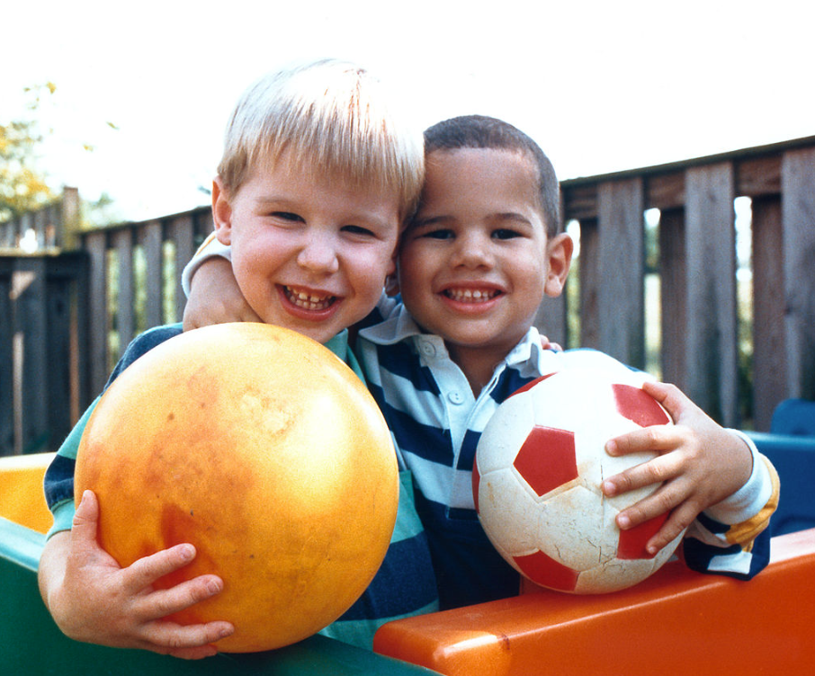
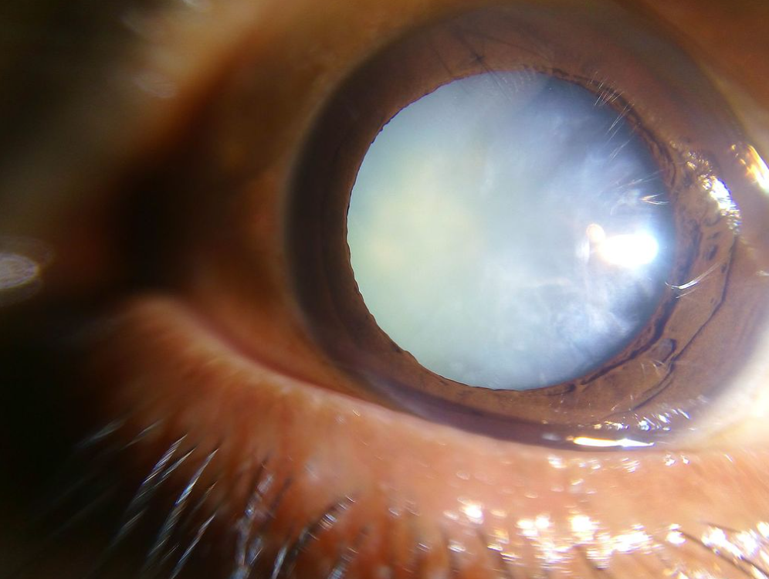
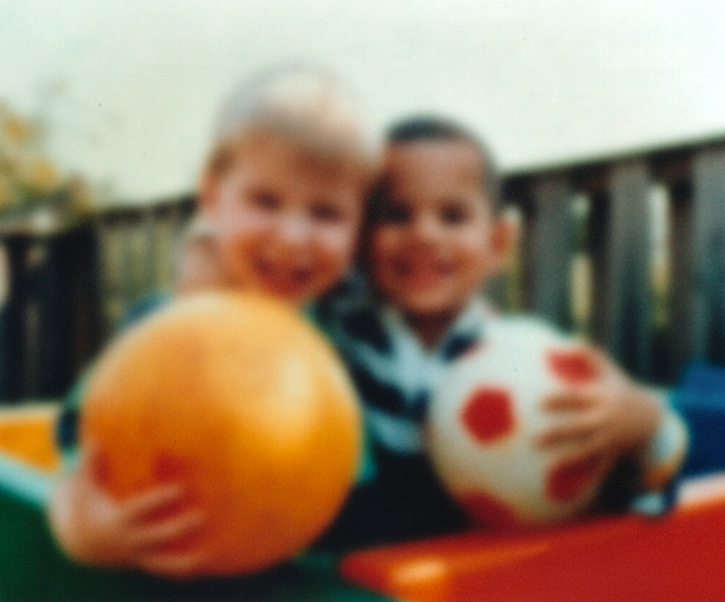
1. Detecting eye disease
Normal vision
Eye Disease - Cataract

Slide 5
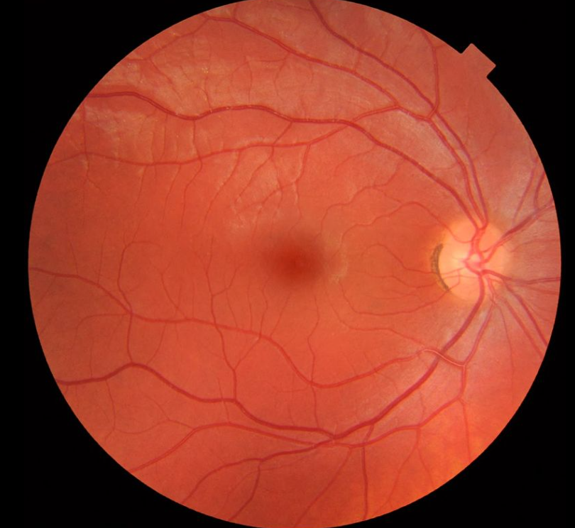
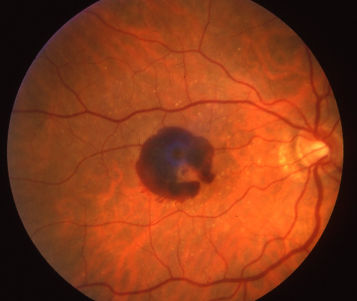
Detecting eye disease
Healthy internal eye
Wet macular degeneration : haemorrhage

Slide 6
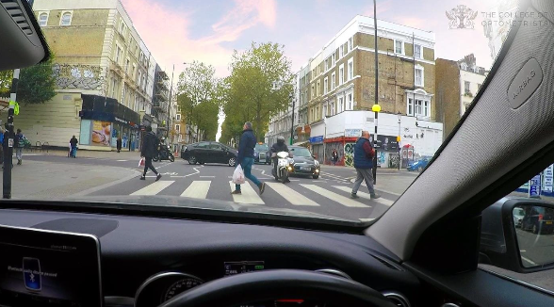
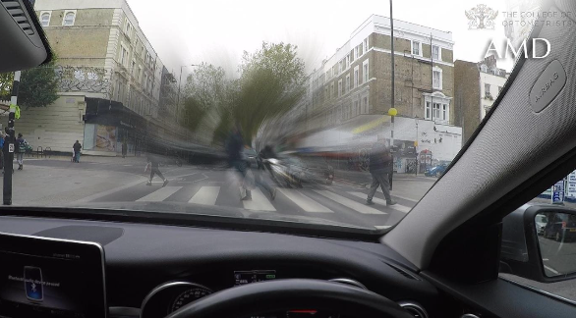


Detecting eye disease
Normal vision
Eye Disease – wet macular degeneration

Slide 7
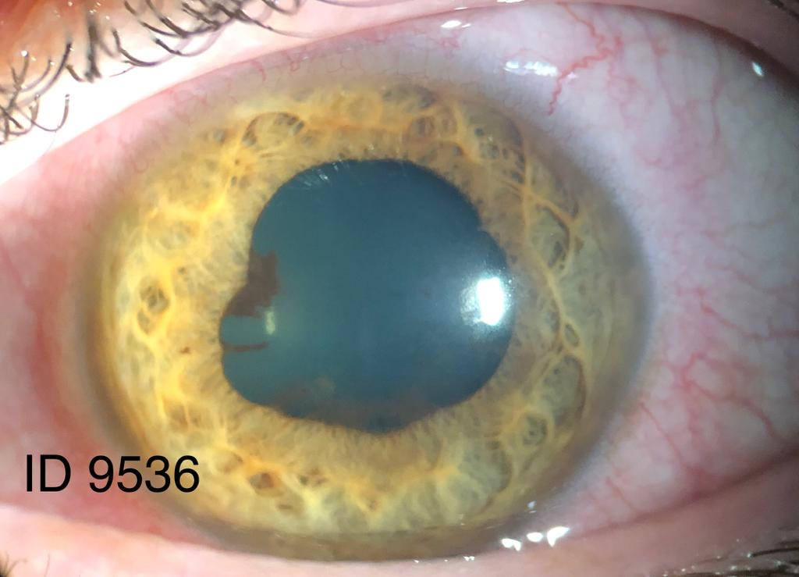

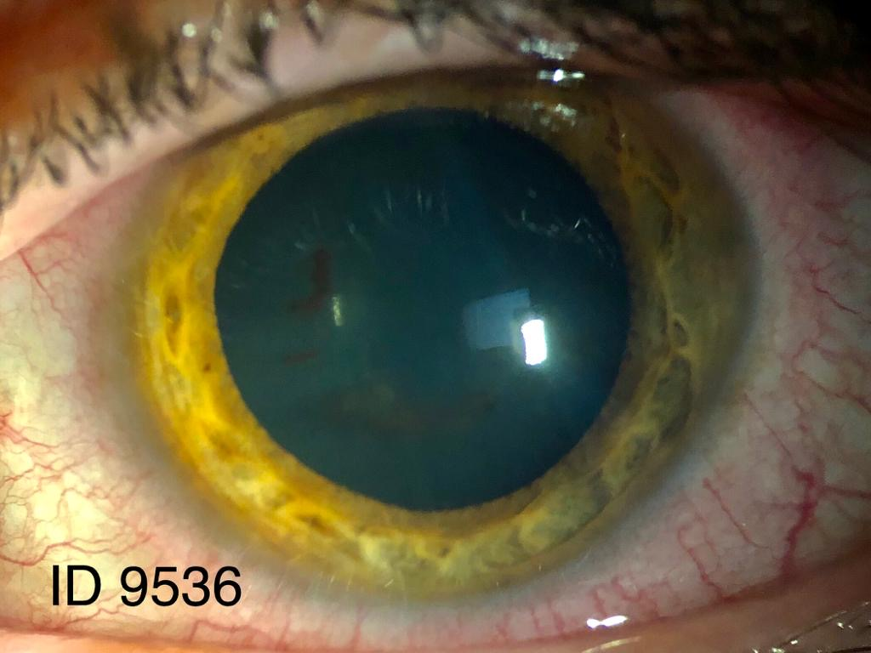
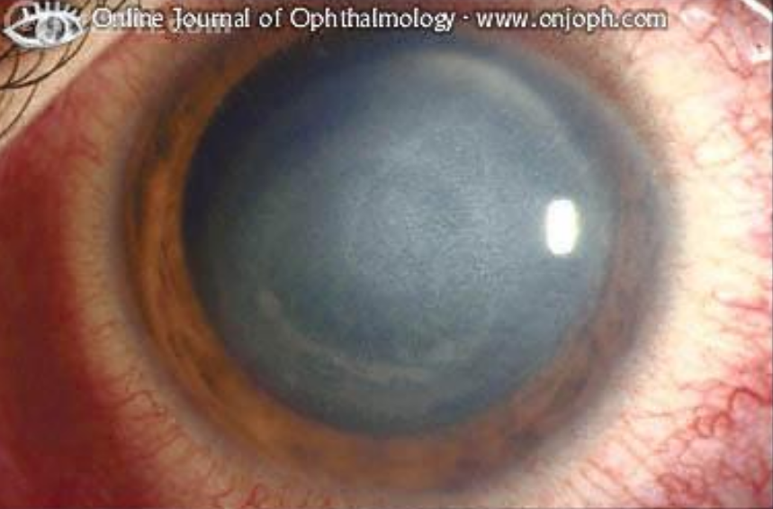
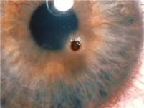
2. Treating eye disease
Before treatment
Eyedrops
After treatment
Virus infection
Metal removal

Slide 8
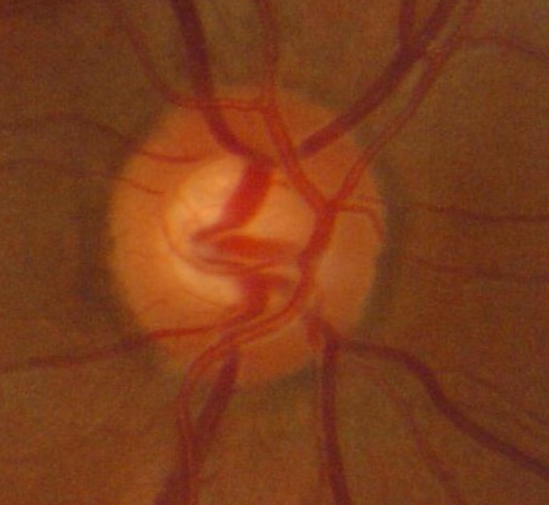
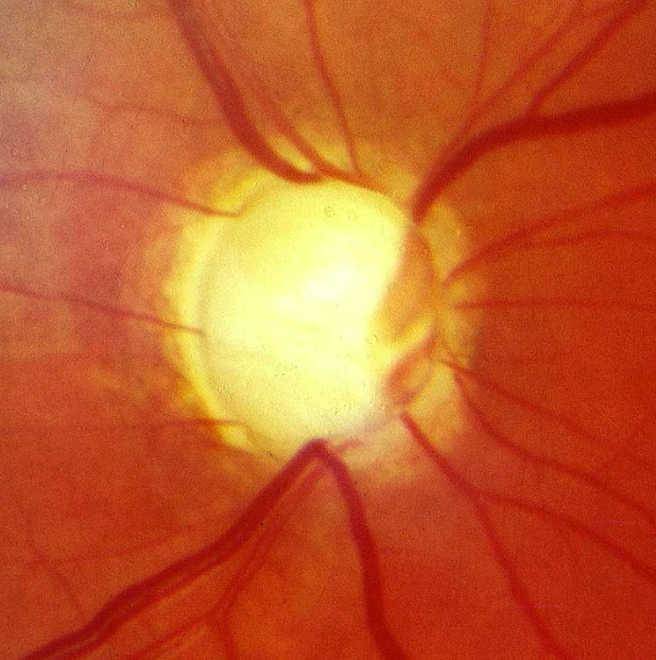
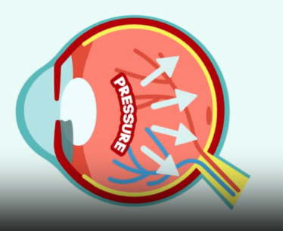

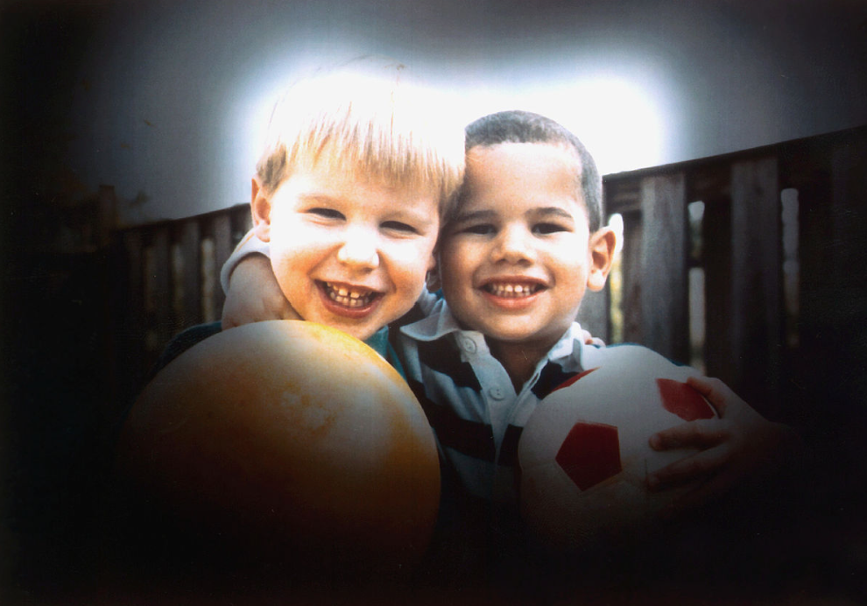
3. Monitoring eye disease e.g. Glaucoma
Normal eye nerve
Glaucoma disease

Slide 9
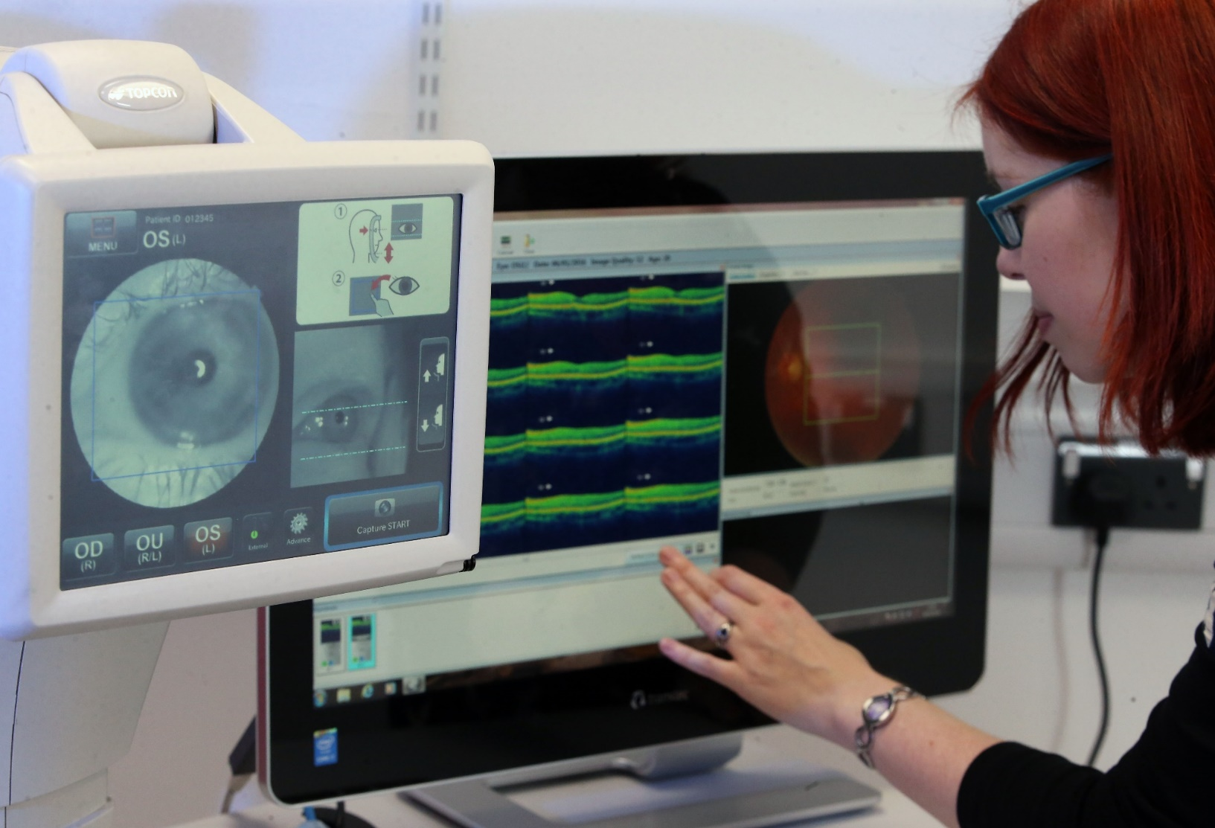
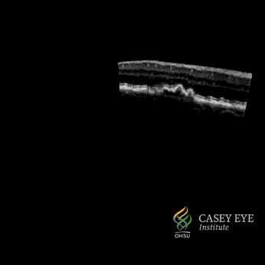
The latest technology: Eye scans (OCT)
By NextOptics - Own work, CC BY-SA 4.0, https://commons.wikimedia.org/w/index.php?curid=137658957

Slide 10
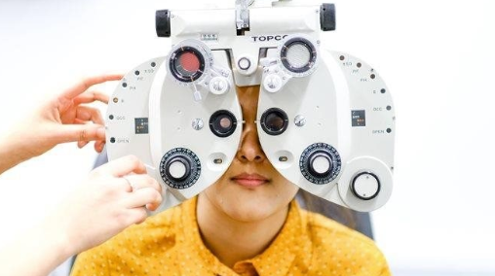
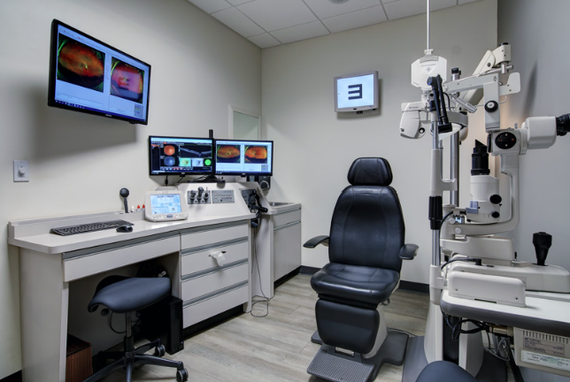
4. Correcting vision
Myopia (short-sightedness)
Hyperopia (long-sightedness)
Astigmatism
Presbyopia (reading glasses/varifocals)

Slide 11
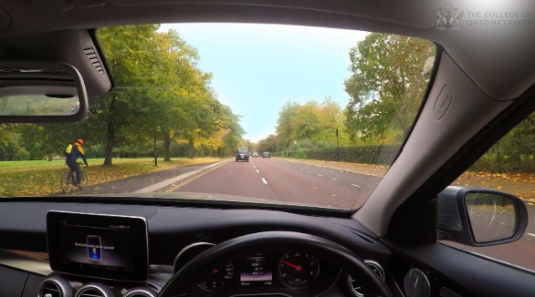
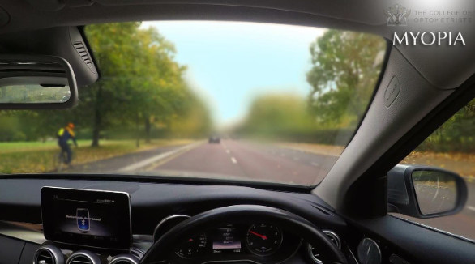
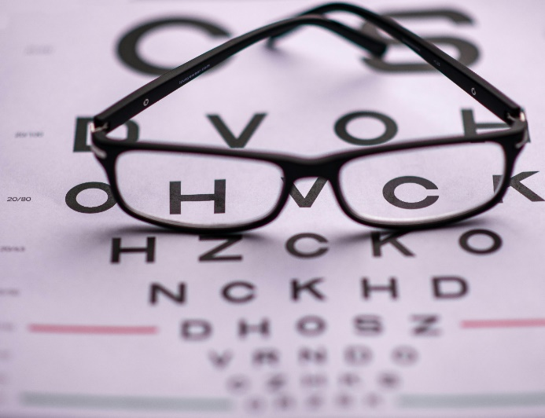
Correcting vision
Normal vision
Short-sighted

Slide 12

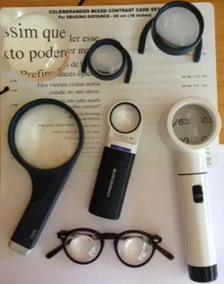
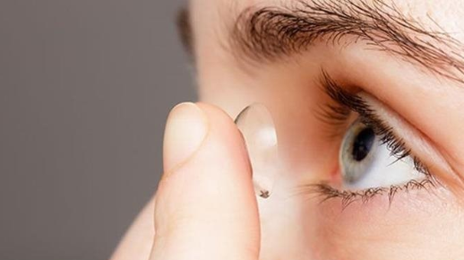
Improving people’s vision

Slide 13
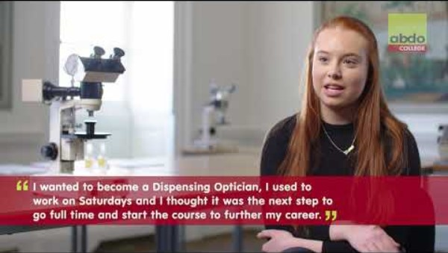
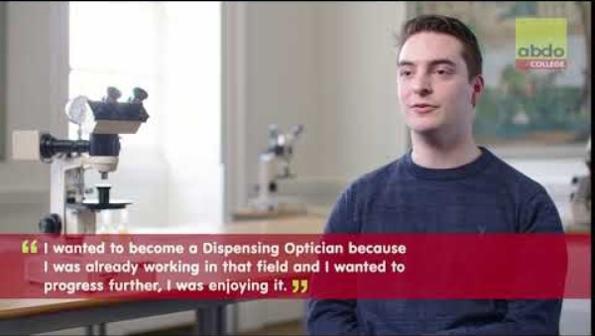
What is a Dispensing Optician?
https://youtu.be/wVk2e8p6q1c?si=cihBDMK06YXtqA67
Dispensing optician careers - go with something you enjoy - YouTube

Slide 14



Career options for Dispensing Opticians

Slide 15

What is a Contact Lens Optician?
Contact lens optician – Careers in Eyecare

Slide 16
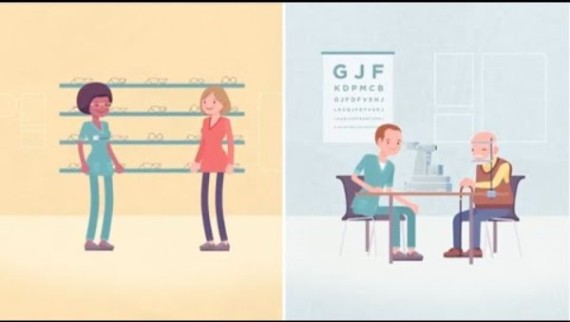
Career options in Optometry
https://youtu.be/9fqvY7zBnd8?si=mkDda16fBz698uNn

Slide 17

Working in Optometry: Benefits
Helping people to see and saving people’s sight
Excellent job satisfaction
Work part time and flexible hours
Run your own business
Can be self-employed (locum)
Choose where you want to work and when
Hospital, high street, university, home visits, research, charity
Career breaks for travelling abroad
Average salary for optometrists is £61,000 when experienced (can be higher for business owners)

Slide 18
Higher Qualifications and Specialties
Glaucoma
Medical Retina (inc. macular degeneration and diabetic eye disease)
Urgent Eye Care and Independent Prescribing
Low Vision (magnifier devices)
Paediatrics (children)
Eye injections
Laser eye treatment for glaucoma
Specialised contact lenses
Cataract assessment
Cardiff University Optometry 4 year MSc includes 1 year working placement
- includes many of the higher qualifications
Notes:
We talked about additional things we can do such as detecting eye disease such as macular degeneration, treating eye disease such as infections, monitoring eye disease such as glaucoma. Every optometrist in wales is trained to provide urgent eye care and many also treat conditions using their Independent prescribing qualification. Many optometrists and dispensing opticians are trained to provide the low vison service for patients living with sight loss. Whilst all optometrists can look after children on the high street, you also have optometrist who specialise just in childrens eye care on the high street and in hospitals. The main treatment for wet macular degeneration is injections into the eye and there are some optometrists in wales that work in hospital who provide these injections into the eye. Some optometrists provide laser treatment in hospital glaucoma clinics. Some optometrists and dispensing opticians have specialist equipment to fit contact lenses for people with certain eye diseases where the eye is diseased or damaged. And in Wales all optometrists help hospital waiting lists by doing certain tests before cataract surgery and providing the after care following cataract surgery. So the day job is very varied and very interesting. The course, is now a four year Optometry Masters Degree course and Cardiff University is the only university in wales but there are universities providing the course in the rest of the UK. I won’t go into details here as Cardiff university provide these details separately but there is a link on the final page if you want further information.

Slide 19
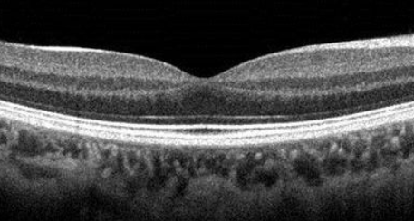
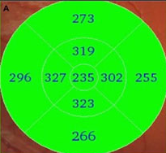
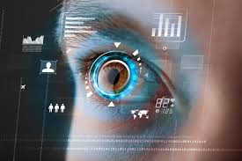
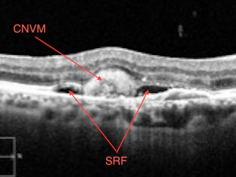
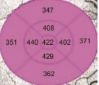
The Future: Artificial Intelligence (AI) and Optometry
Normal retina scan
AI engine says normal
Macular degeneration disease
AI engine says abnormal

Slide 20
Conclusion
More information:
What is an optometrist? - College of Optometrists
Optometry – HEIW
School of Optometry and Vision Sciences - Cardiff University
Career choices
Career guides – Careers in Eyecare
Explore a great career as a dispensing optician – Careers in Eyecare
Dispensing Optician Careers Profile - HEIW
SharonBeatty@Optometrywales.com
Judy.Misra@Optometrywales.com
www.optometrywales.org.uk
Follow us @OptometryWales

