Slide 1


A Career In Optometry
Notes:
Hello, I am Sharon Beatty. I am an Optometrist and I am here today to talk to you about the wonderful opportunities available within the profession of optometry.​
With me is Judy Misra, Chief Executive of Optometry Wales, and we represent all Optometrists, Dispensing Opticians and Optometry practices in Wales.
If you press play on the videos and they do not play on your device, you can click the YouTube link below the video.

Slide 2


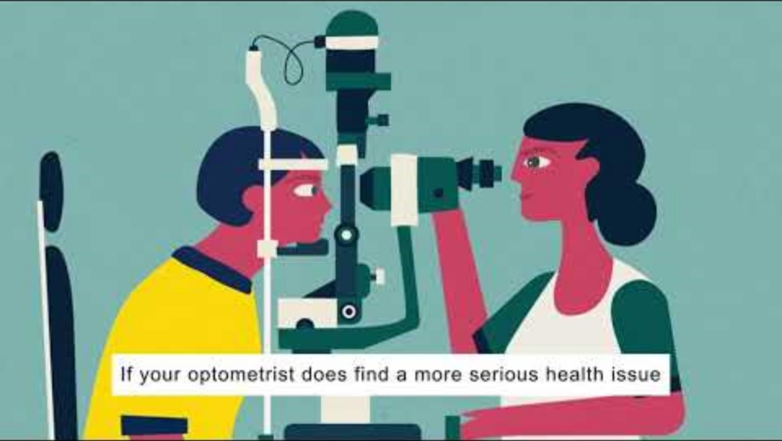
What is an Optometrist?
https://youtu.be/UAm8HDMK_es?si=tUnxLKoOIrfa-1Fr
Notes:
Optometry is a healthcare profession that involves the examination, treatment, management of eye diseases and vision problems.​
Here is a short video that explains the role of optometrist or you might know better as optician in more detail. ​

Slide 3
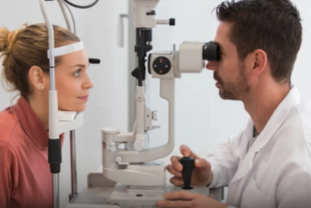

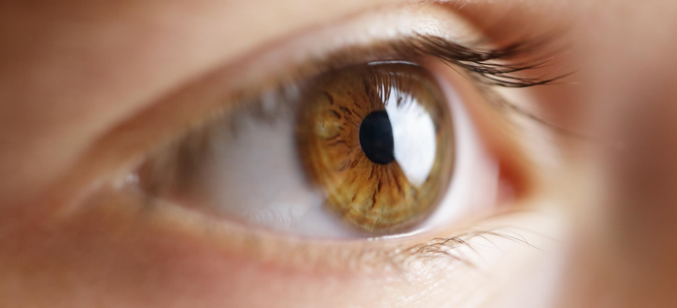
‘Doctor of the eyes’ on the high street
Detecting eye disease
Treating eye disease
Monitoring eye disease
Correcting vision
Notes:
So what do we do from day to day in practice. In Wales around 80% of our work is for NHS patients. Many people think that visiting their optometrist is just to have a sight test to check if you need glasses or spectacles but in fact a large part of the sight test is examining the eyes for signs of eye disease. Our main role is to detect eye disease or eye conditions, we can also treat eye conditions or disease and if a patient with a more complex eye disease needs treatment at hospital, we can then monitor those eye diseases once stable to free up hospital appointments for other patients. By detecting, treating or monitoring eye diseases the aim is to prevent sight loss. Most eye diseases cause irreversible loss of sight so it is an incredibly important role to catch eye diseases early. We are ina fortunate position in Wales where the Welsh Government are very supportive of optometrists working closely with eye specialists to use our qualifications to the best potential.

Slide 4
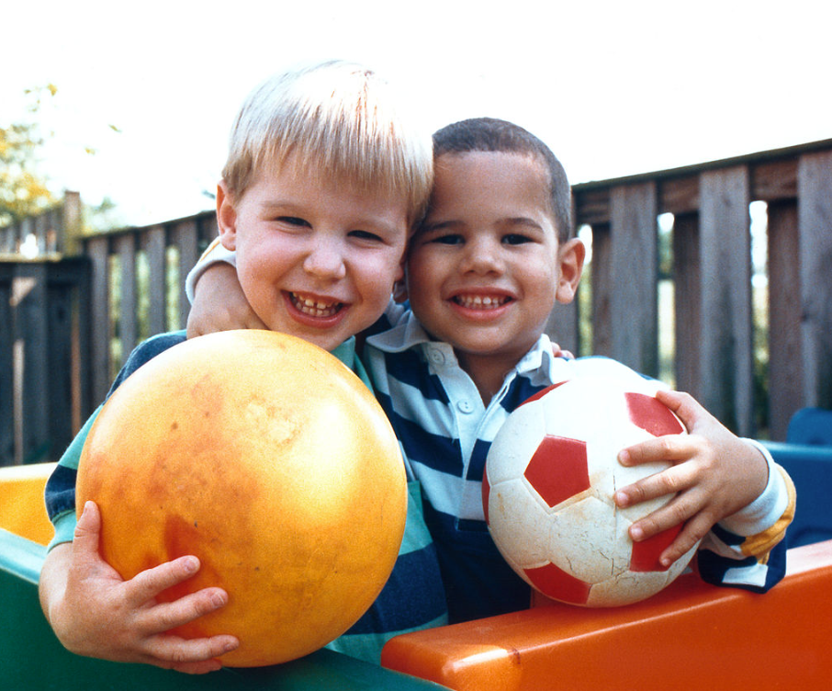
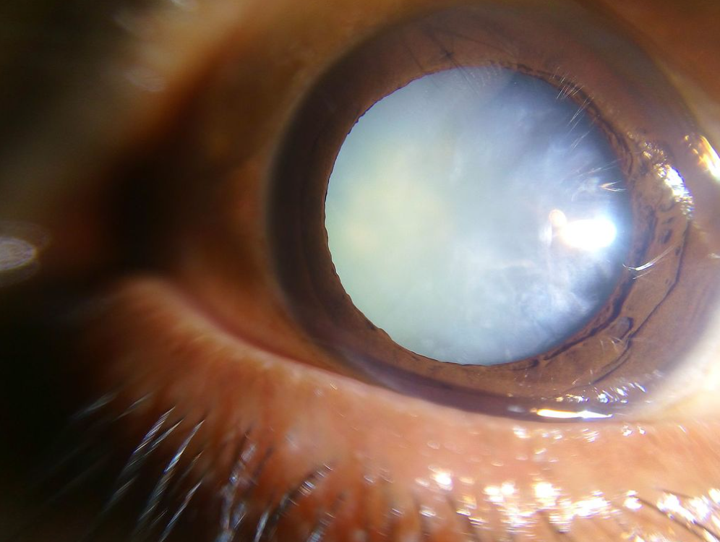
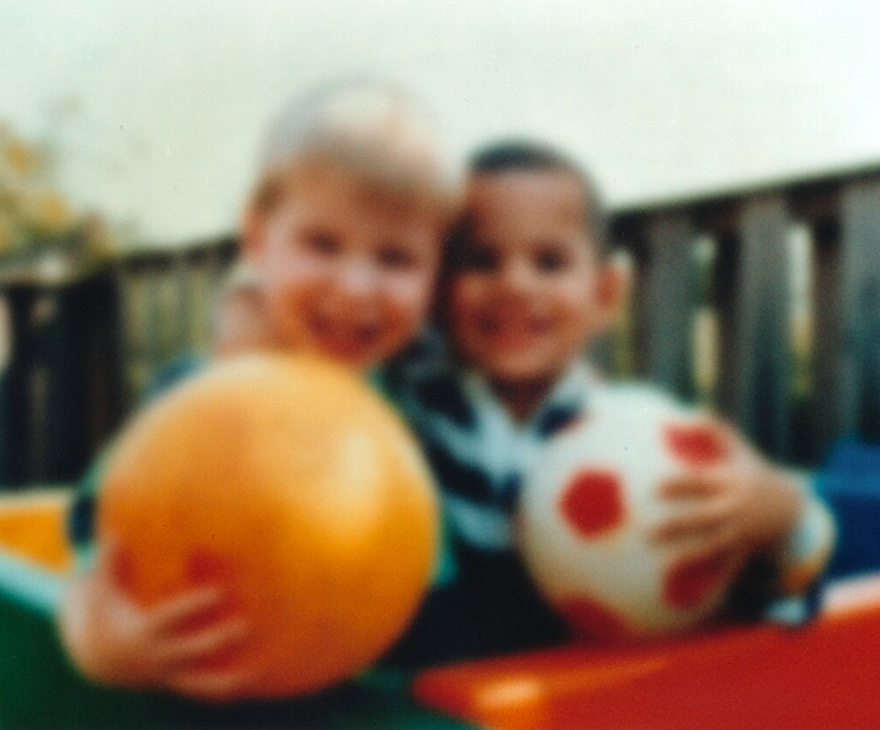
1. Detecting eye disease
Normal vision
Eye Disease - Cataract
Notes:
So what sort of eye diseases are we detecting on a regular basis. Well you’ve probably all heard of cataract, this is something that we will all develop if we are lucky to live long enough. It causes the lens in the eye to go cloudy and makes the vision appear blurry – the picture of the children on the left is what normal sight should look like and the picture on the right is an example of what a cataract can do to your vision. In Wales, we provide advice and additional tests on behalf of eye consultants before cataract surgery and when the surgery is over, we also provide the aftercare instead of the patient having to return to hospital for a check up.

Slide 5
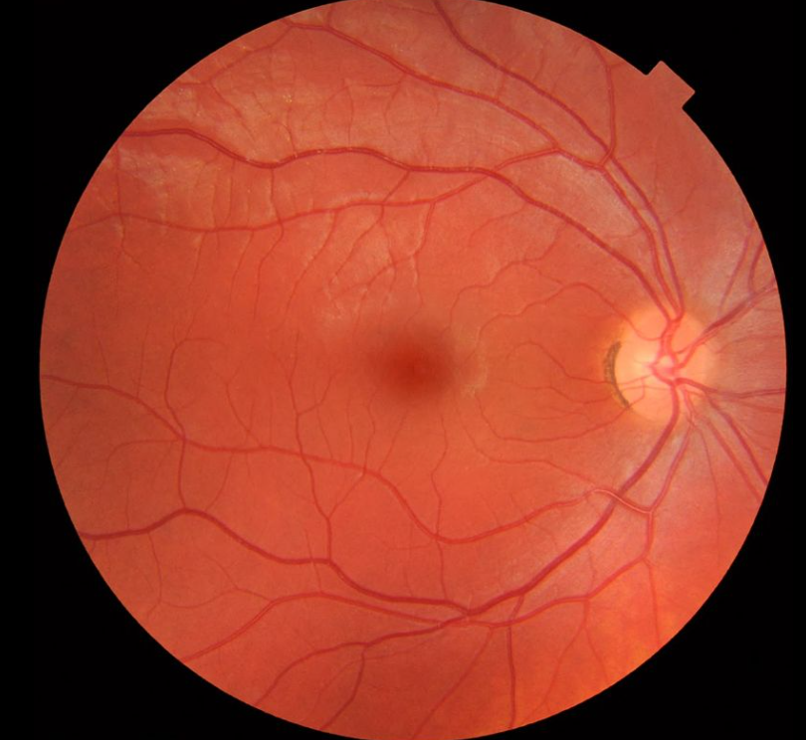
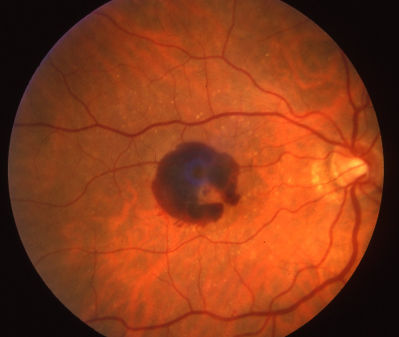
Detecting eye disease
Healthy internal eye
Wet macular degeneration : haemorrhage
Notes:
Another eye disease you may have heard of is macular degeneration. When we look inside the eye, you can see the image on the left hand side. The little red lines are blood vessels inside the eye, the yellow circle is the nerve that goes from the eye to the brain and the cherry red spot in the middle is called the macula which is what we use for most of our vision in the centre, so people’s faces, driving etc. On the right hand side you can see a red patch, this is where bleeding has occurred at the back of the eye from a condition called wet macular degeneration. This needs to be treated urgently at hospital or else the patient will lose all of their vision in the centre permanently.
Also the blood vessels can tell you a lot about someones general health, for example if you have high blood pressure it could be detected by changes to the blood vessels or for diabetes, some blood vessels may bleed, and because the eyes are linked to the brain via the optic nerve, you can even pick up some brain tumours of they are pressing on the nerves and In some cases some eye problems may be due to a stroke or multiple sclerosis.

Slide 6
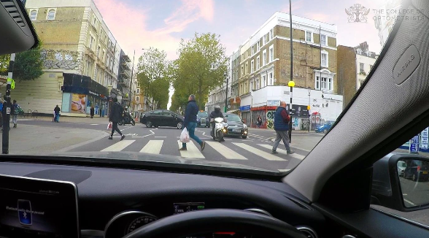
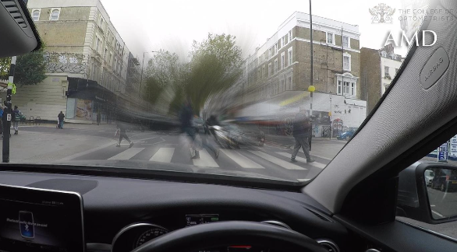
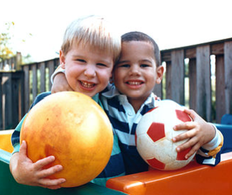
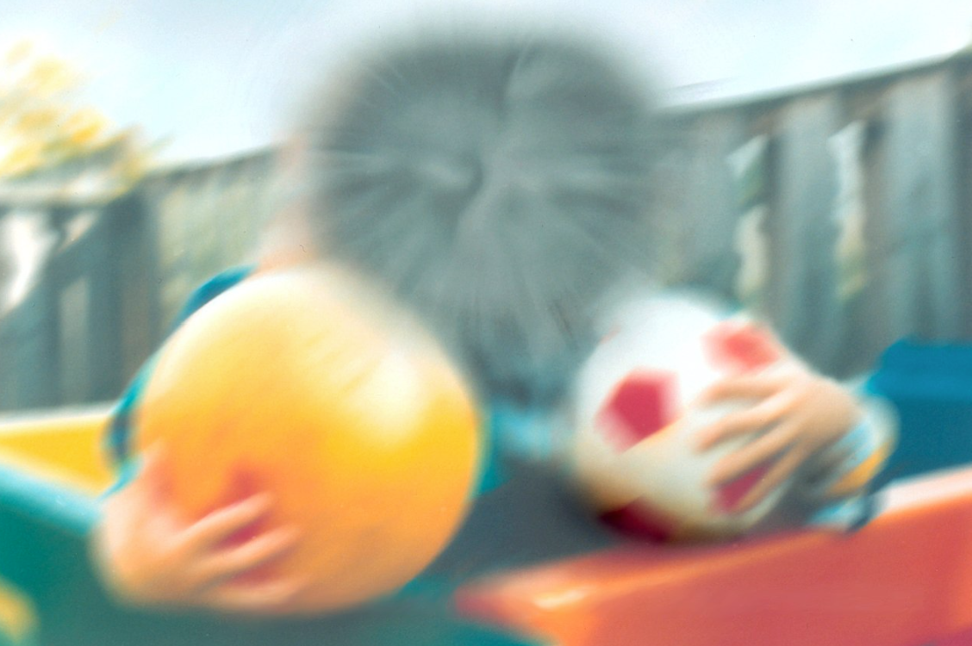
Detecting eye disease
Normal vision
Eye Disease – wet macular degeneration
Notes:
This slide shows again normal vision on the left hand side, but when wet macular degeneration occurs the bleed in the centre of the eye causes you to lose that vision in the centre. If the condition is not detected early and if the patient is not treated quicky at hospital, then the vision may be permanently lost.

Slide 7
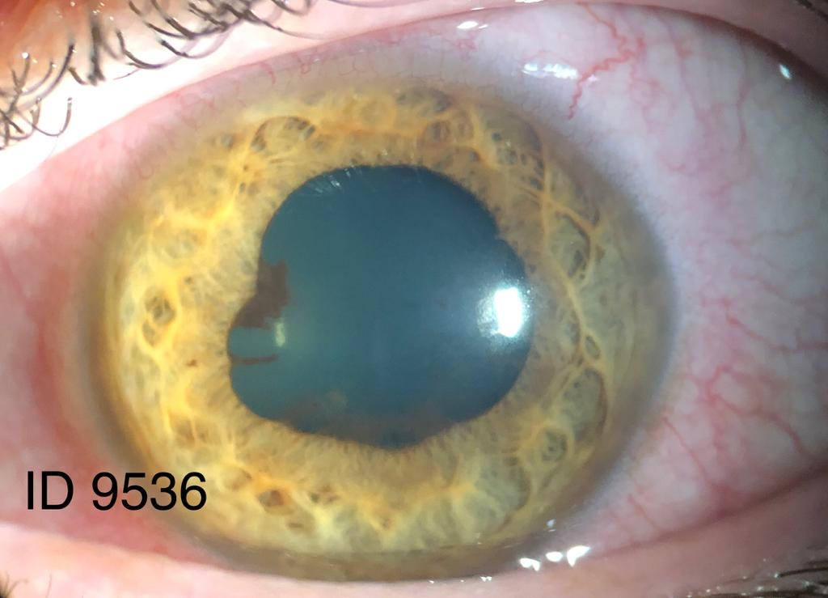
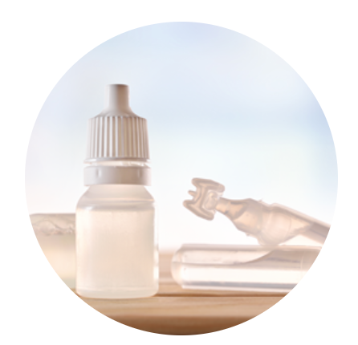
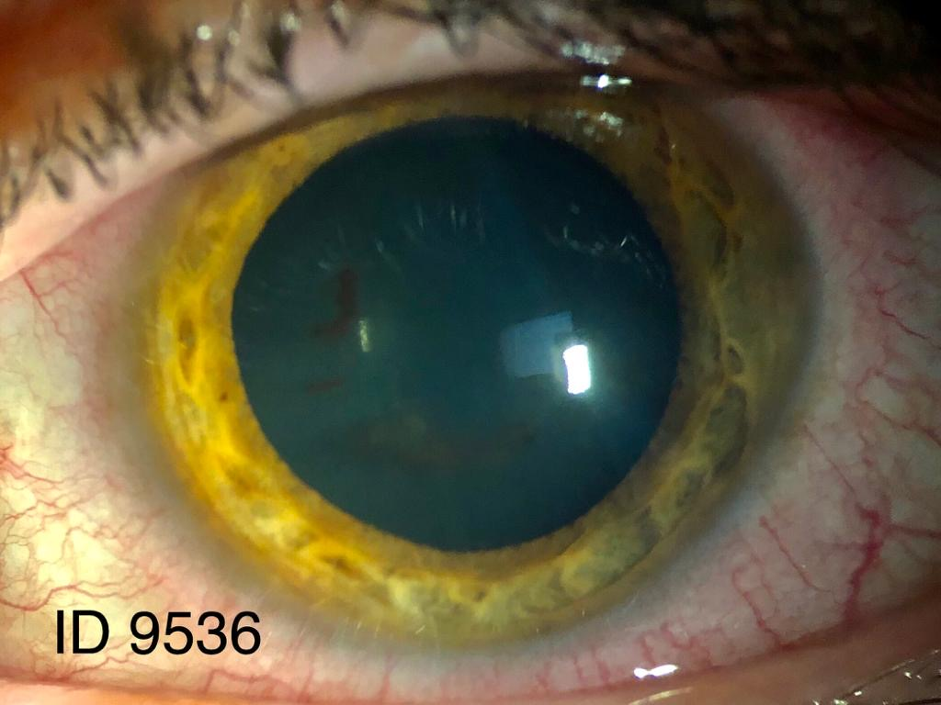
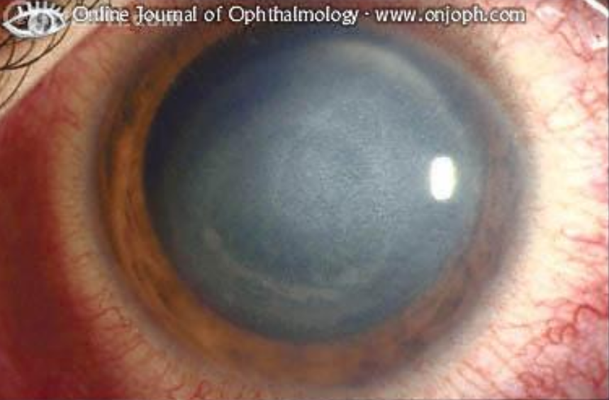
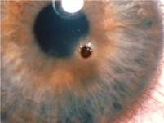
2. Treating eye disease
Before treatment
Eyedrops
After treatment
Virus infection
Metal removal
Notes:
So those were some examples of where Optometrists routinely detect eye diseases as part of the day job, Optometrists will regularly see cataracts in clinic and will also see macular degeneration cases.
There are 100s of eye conditions so a large part of the university Masters degree course is learning to identify and how to manage the conditions or refer them to a colleague in hospital. Many optometrists are now becoming independent prescribers, that means once you have identified an eye disease you can then write an NHS prescription so that the patient can collect the eyedrops straight form the Pharmacist rather than having to go to hospital or to their GP. The training for this is now becoming part of some Masters University courses. On the top, is an eye condition where you get inflammation inside your eye called uveitis and it can cause the pupil to become an irregular shape. If you are an independent prescriber , you can prescribe steroid eye drops to treat the disease and so the patient can avoid going to A and E or eye casualty. At the bottom left, this patient has a virus in their eye and again can be treated by Optometrists with antivirals. The bottom right, the patient has got a piece of metal stuck to their eye and practitioners are all trained to use instruments to be able to remove the metal and issue eyedrops if needed. Some optometrists choose not to sell glasses at all and only look after eye diseases.

Slide 8
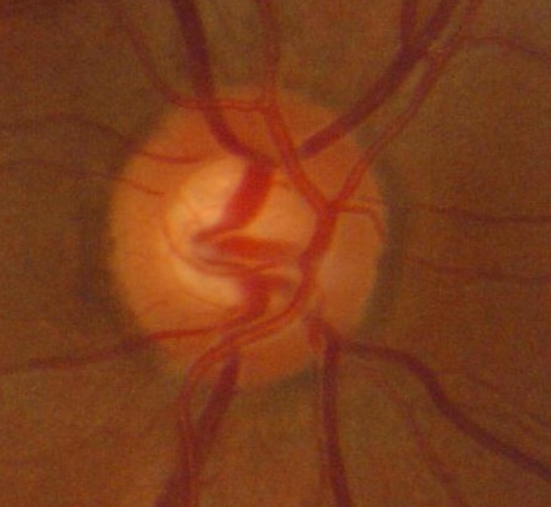
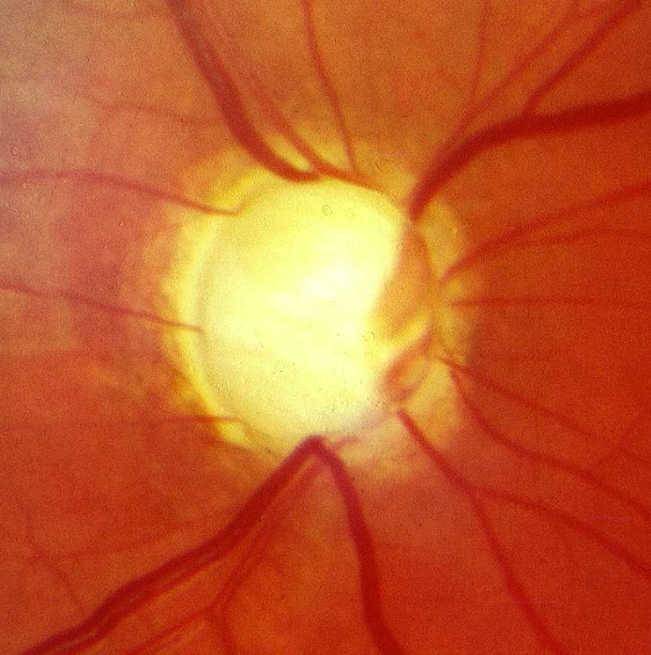
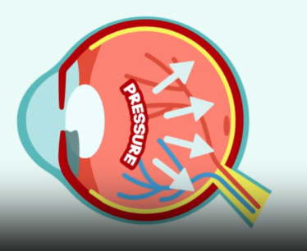
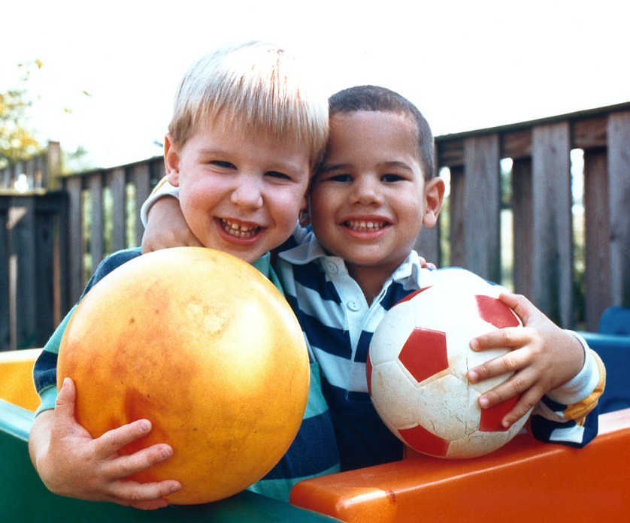
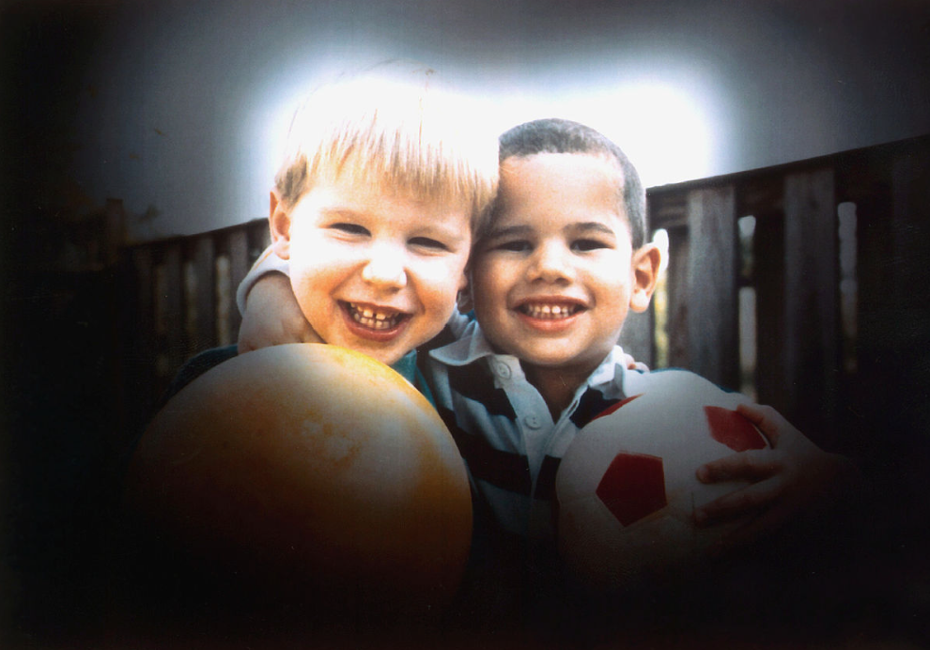
3. Monitoring eye disease e.g. Glaucoma
Normal eye nerve
Glaucoma disease
Notes:
The third part of the Optometrist role is monitoring eye diseases such as glaucoma. Glaucoma is usually caused by a build of pressure inside the eye and it causes damage to the nerves at the back of the eye called the optic nerve. You can see this image here is an optic nerve which is nice and pink and on the right it is very yellow and almost white from damage – these nerves have died and will not recover. Damaged nerves will lead to a tunnel vision affect and it is normally a painless eye disease so the sooner Optometrists can catch it and have treatment started at hospital the better. Treatment is normally via eyedrops but may be via surgery or laser if needed. Once a patient is stable with their glaucoma eye drops , they are discharged back to an optometrist who has specialised in glaucoma having obtained additional glaucoma qualifications, As this is a lifelong condition, Optometrists in Wales can monitor the patient for life and either change their eyedrops if have qualified with the Independent Prescribing qualification.

Slide 9
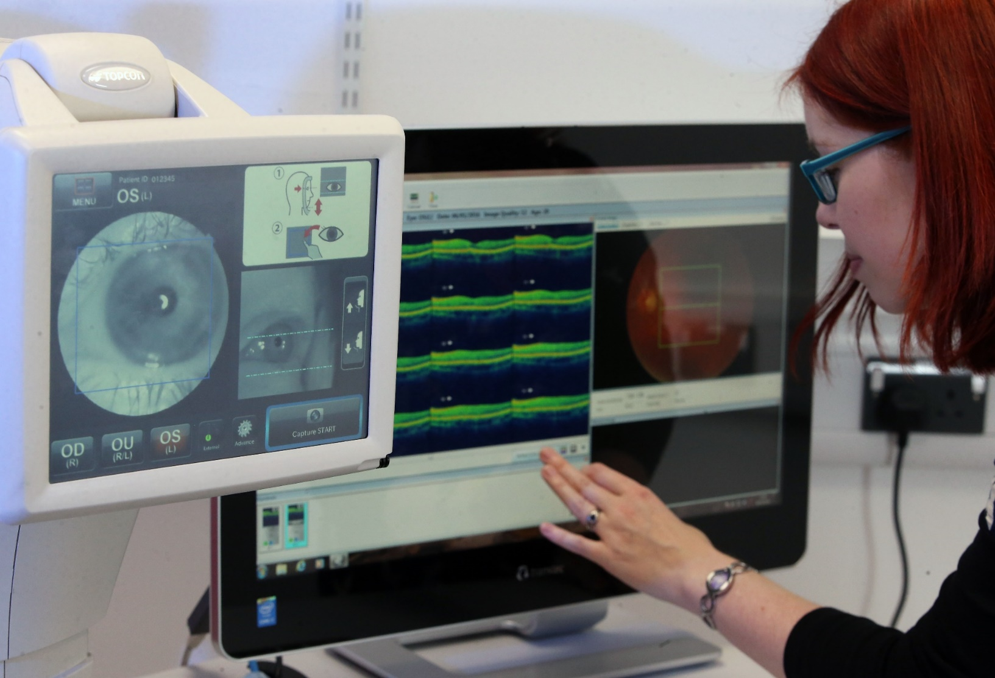
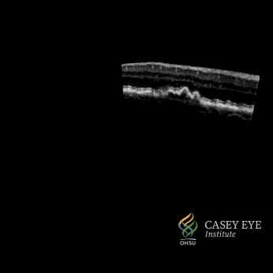
The latest technology: Eye scans (OCT)
By NextOptics - Own work, CC BY-SA 4.0, https://commons.wikimedia.org/w/index.php?curid=137658957
Notes:
The technology that is used as part of a sight test and eye examination is the very latest. This machine you can see here is called an OCT scan and it is taking microscopic scans of the retina at the back of the eye so practitioners can often detect problems even before the patient notices anything in their vision. These are the same machines that hospital eye clinics use, so pactices are using hospital grade equipment on the hight street.

Slide 10
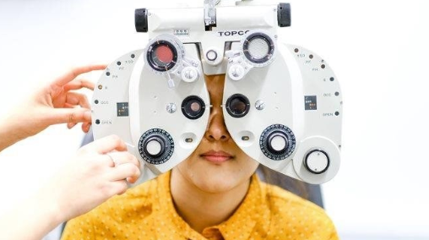
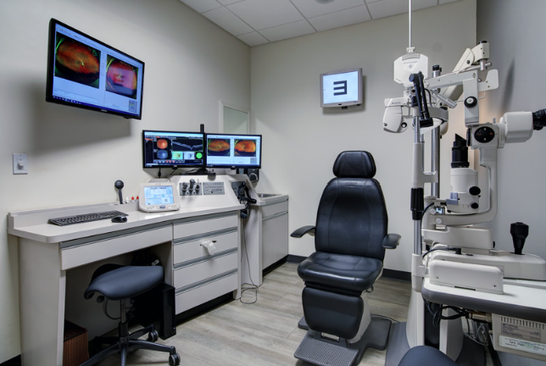
4. Correcting vision
Myopia (short-sightedness)
Hyperopia (long-sightedness)
Astigmatism
Presbyopia (reading glasses/varifocals)
Notes:
As well as detecting, treating and monitoring eye disease, Optometrists will test eyesight and prescribe glasses or contact lenses to correct these conditions. Technology has advanced significantly and there are machines that provide practitioners with an estimate of the spectacle prescription before even starting to perform the sight test. Here is a picture of a phoropter machine which is used that contains all the lens strengths to determine the best spectacle lens for your eyes..

Slide 11
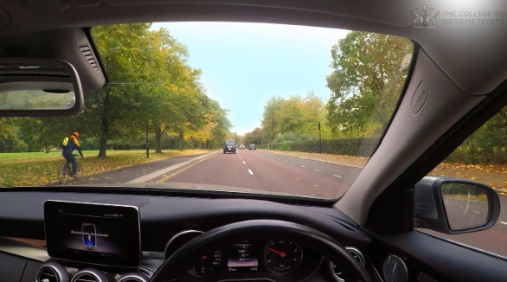

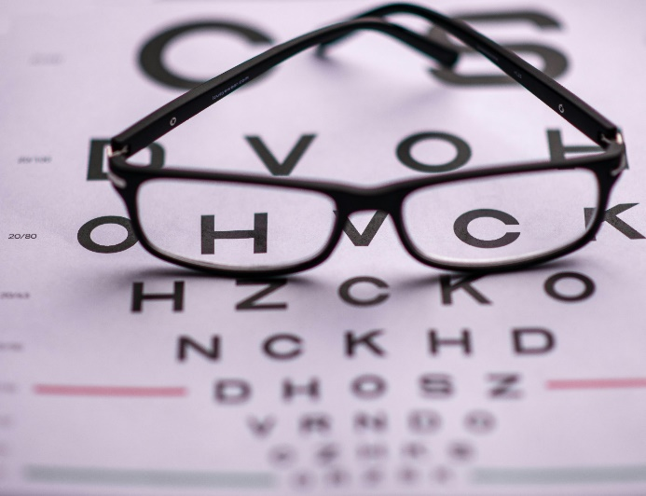
Correcting vision
Normal vision
Short-sighted
Notes:
So the picture on the left is how people with normal vision see with their spectacles, and the picture on the right is blurry without spectacles. Being able to give the gift of sight is a real privilege and patients can choose to wear spectacles or contact lenses or may even choose laser correction. An important part of the job is providing the best advice and your glasses prescription can change over time so we advise when the next eye exam is due.

Slide 12

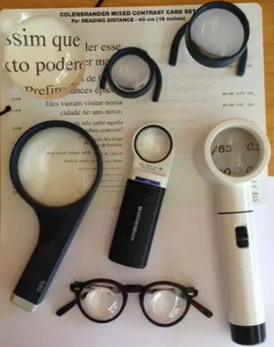
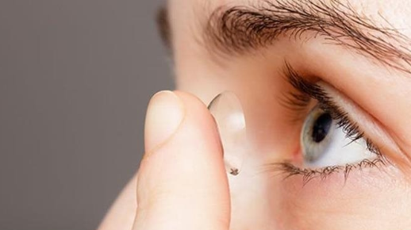
Improving people’s vision
Notes:
What about those people who have lost their sight through certain eye diseases that can no longer be corrected by glasses? some optometrists and dispensing opticians have trained to provide the low vison service where devices such as magnifying devices are issued that support people to be able to read their post for example and see the TV. Practitioners also work with social services and charity organisations to support people to live independent lives. Therefore practitioners never work in isolation, they work with GPs, Pharmacists, social services, charities to provide an all round service for the benefit of the patient.

Slide 13
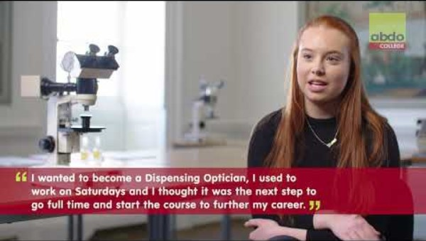
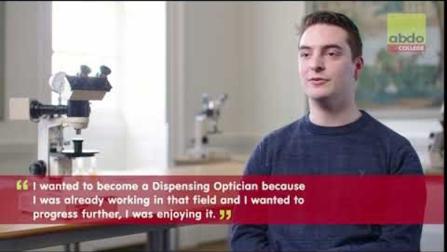
What is a Dispensing Optician?
https://youtu.be/wVk2e8p6q1c?si=cihBDMK06YXtqA67
Dispensing optician careers - go with something you enjoy - YouTube
Notes:
A dispensing optician (DO) advises on, fits and supplies the most appropriate spectacles after taking account of each person’s visual, lifestyle and vocational needs. Dispensing opticians also play an important role in advising and dispensing low vision aids to those who are partially sighted as well as advising on and dispensing to children where appropriate. In Wales, Dispensing Opticians can accredit to provide the Low Vision Service Wales where they provide the assessment to determine which low vision aids may support people with Low Vision. They are also able to fit and provide aftercare for contact lenses after undergoing further specialist training. Career opportunities also exist to develop business skills in marketing and practice management.
You can become a Dispensing Optician while you work – earn while you learn. You can complete a BSc at university full time, or via a three-year distance learning course, including a four-week residential block. Or there’s a three-year, day release course. There is also the option to take a two-year, full-time diploma course, followed by one year working under supervision.

Slide 14
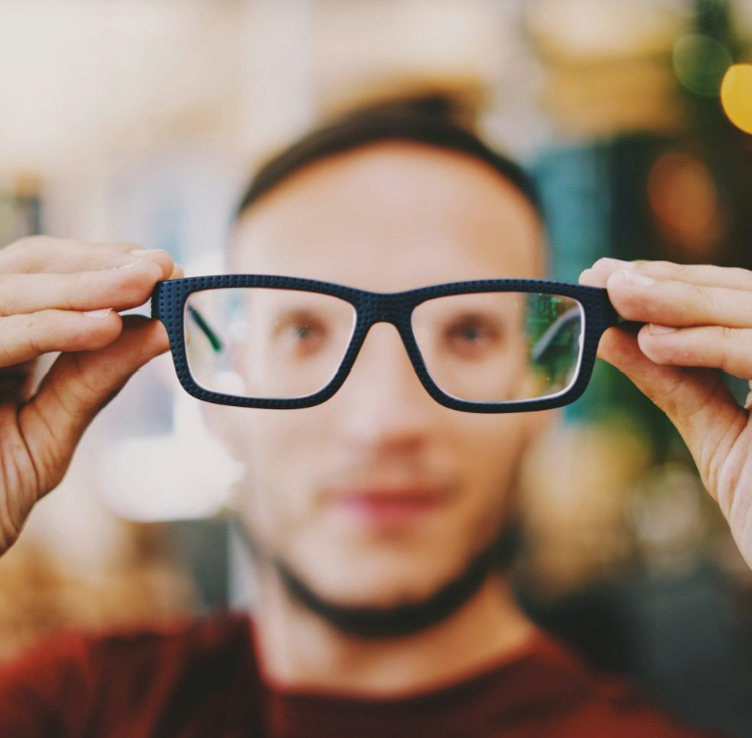

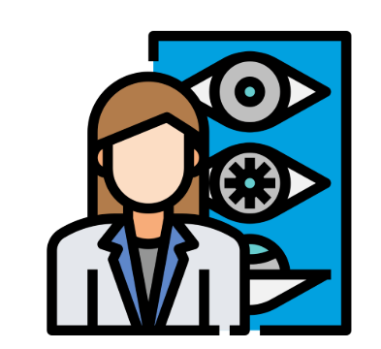
Career options for Dispensing Opticians
Notes:
There are many routes to develop a career as a Dispensing Optician. Professionals can earn while they learn with an apprenticeship, study via distance learning or day release, or go to University. Once qualified, some Dispensing Opticians enjoy working in high street practices. Others work in hospitals, or commence roles in the lens manufacturing industry.
The job can offer a range of different working patterns, giving flexibility. You get to engage with people, making a difference to their lives by providing eyewear, eyecare and advice. If you want to progress you can go into management or take further training to become a contact lens optician or an optometrist.

Slide 15

What is a Contact Lens Optician?
Contact lens optician – Careers in Eyecare
Notes:
A contact lens optician specialises in fitting contact lenses and ensuring people look after their lenses and their eyes. It’s such a tiny object, but a contact lens can completely change someone’s life for the better, helping them to see more clearly and boost their self-confidence.
Contact lens opticians (CLOs) specialise in the fitting and supply of contact lenses, some practitioners work in high street optometry practice and some practitioners work in the hospital eye service managing a range of complex eye conditions through fitting of specialised contact lenses.. This is a growing profession, and one that is full of rewards. As well as supplying contact lenses, a contact lens optician can also qualify in Urgent Eye Care.
Contact lens opticians can train to provide NHS services and in Wales can manage a range of urgent eye care conditions that affect the anterior part of the eye.

Slide 16
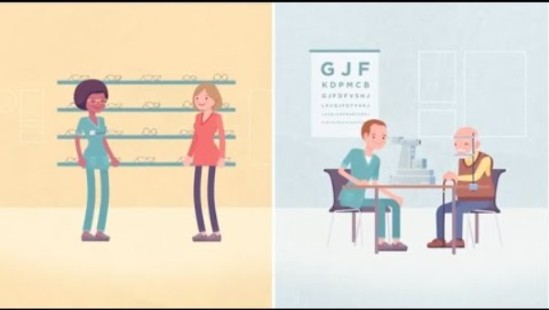
Career options in Optometry
https://youtu.be/9fqvY7zBnd8?si=mkDda16fBz698uNn
Notes:
Here is a video which summarises the discussions so far and also tells you a bit more about other career options available for optometrists and dispensing opticians.

Slide 17

Working in Optometry: Benefits
Helping people to see and saving people’s sight
Excellent job satisfaction
Work part time and flexible hours
Run your own business
Can be self-employed (locum)
Choose where you want to work and when
Hospital, high street, university, home visits, research, charity
Career breaks for travelling abroad
Average salary for optometrists is £61,000 when experienced (can be higher for business owners)
Notes:
Students ask Why should I study optometry over all the other healthcare professions. There is immense job satisfaction in being able to help someone to see. If you ask anyone what they fear losing the most with their health, most people will say losing their sight is their biggest fear. So detecting and treating eye diseases to help stop people losing their sight brings immense job satisfaction. You can work full time , you can work part time, you can work half days or full days, You can run you own business, you can be self employed and work as a locum if you want to work in different practices. You can choose your location where you work, You can work in various settings such as hospital, university, you can provide home visits, you can support charities who provide eye tests for people who are homeless as example. IN fact, you will find some people mix and match their week to do several different roles at a time. You can take a career break to go travelling and it won’t affect your career opportunities. When experienced average salaries for Optometrists are around £61,00 but this can be significantly higher if you run your own business.

Slide 18
Higher Qualifications and Specialties - add picture/s
Glaucoma
Medical Retina (inc. macular degeneration and diabetic eye disease)
Urgent Eye Care and Independent Prescribing
Low Vision (magnifier devices)
Paediatrics (children)
Eye injections
Laser eye treatment for glaucoma
Specialised contact lenses
Cataract assessment
Cardiff University Optometry 4 year MSc includes 1 year working placement
- includes many of the higher qualifications
Notes:
We talked about additional things we can do such as detecting eye disease such as macular degeneration, treating eye disease such as infections, monitoring eye disease such as glaucoma. Every optometrist in wales is trained to provide urgent eye care and many also treat conditions using their Independent prescribing qualification. Many optometrists and dispensing opticians are trained to provide the low vison service for patients living with sight loss. Whilst all optometrists can look after children on the high street, you also have optometrist who specialise just in childrens eye care on the high street and in hospitals. The main treatment for wet macular degeneration is injections into the eye and there are some optometrists in wales that work in hospital who provide these injections into the eye. Some optometrists provide laser treatment in hospital glaucoma clinics. Some optometrists and dispensing opticians have specialist equipment to fit contact lenses for people with certain eye diseases where the eye is diseased or damaged. And in Wales all optometrists help hospital waiting lists by doing certain tests before cataract surgery and providing the after care following cataract surgery. So the day job is very varied and very interesting. The course, is now a four year Optometry Masters Degree course and Cardiff University is the only university in wales but there are universities providing the course in the rest of the UK. I won’t go into details here as Cardiff university provide these details separately but there is a link on the final page if you want further information.

Slide 19
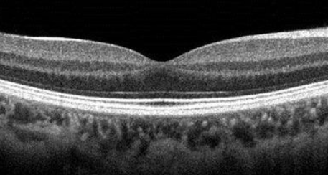
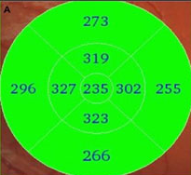
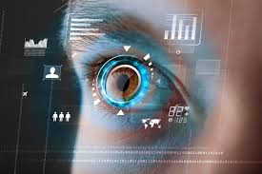
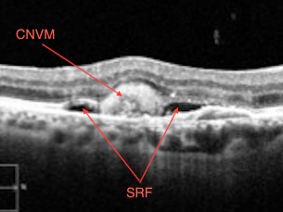
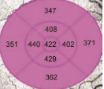
The Future: Artificial Intelligence (AI) and Optometry
Normal retina scan
AI engine says normal
Macular degeneration disease
AI engine says abnormal
Notes:
And we all talk about AI, how will it affect our work. Well in optometry we are already using AI as a tool to help us make decisions. When I talked about the OCT scan earlier, the top image is a normal scan of the back of an eye and the AI engine automatically produces a green code to say the thickness of the tissue is normal. The bottom picture is a wet macula degermation and the AI engine tells me that the thickness of the tissue is abnormal. So AI is used more to support our decisions and not replace our decisions and an optometrist will always be needed to interpret those scans and provide advice on treatment and management for eye disease but it is certainly an exciting tool that we will make best use of.

Slide 20
Conclusion
More information:
What is an optometrist? - College of Optometrists
Optometry – HEIW
School of Optometry and Vision Sciences - Cardiff University
Career choices
Career guides – Careers in Eyecare
Explore a great career as a dispensing optician – Careers in Eyecare
Dispensing Optician Careers Profile - HEIW
SharonBeatty@Optometrywales.com
Judy.Misra@Optometrywales.com
www.optometrywales.org.uk
Follow us @OptometryWales
Notes:
So here are some links, that we will make available to anyone interested in pursuing optometry as a career. And of course feel free to contact Optometry Wales if you would like to discuss a placement or want more information on anything you have heard today.

